Slide 1
Data Science Capstone One
Predicting a model for ticket prices - Big Mountain Resort

Slide 2
The Problem
Company
Context
Problem statement
Premium ski resort in Montana
105 trails
350K visitors annually
Skiers of all levels/abilities
Operating expenses increase by $1,540,000
Wants better value for ticket price
Wants to cut costs
Stay at par with premium resorts
Develop a pricing strategy
Capitalize on its premium facilities
Maintain sustainable, competitive market position
Cut down operating costs

Slide 3
Recommendation &
Key Findings
Eight best features positively impacting ticket price:
𝑣𝑒𝑟𝑡𝑖𝑐𝑎𝑙𝑑𝑟𝑜𝑝, 𝑆𝑛𝑜𝑤𝑀𝑎𝑘𝑖𝑛𝑔𝑎𝑐, 𝑡𝑜𝑡𝑎𝑙𝑐ℎ𝑎𝑖𝑟𝑠, 𝑓𝑎𝑠𝑡𝑄𝑢𝑎𝑑𝑠, 𝑅𝑢𝑛𝑠, 𝐿𝑜𝑛𝑔𝑒𝑠𝑡𝑅𝑢𝑛𝑚𝑖, 𝑡𝑟𝑎𝑚𝑠, 𝑆𝑘𝑖𝑎𝑏𝑙𝑒𝑇𝑒𝑟𝑟𝑎𝑖𝑛𝑎𝑐
Modelled price is 95.26, Actual Price 𝑖𝑠 81.00
Expected mean absolute error of 10.37, suggesting room for an increase

Slide 4
Modelling and Analysis

Slide 5
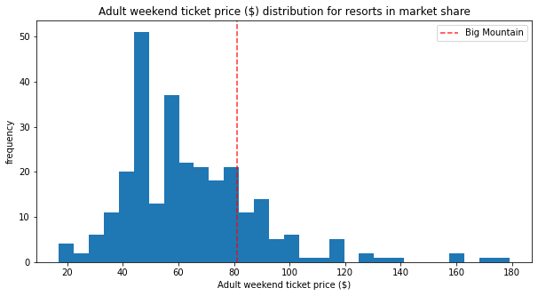
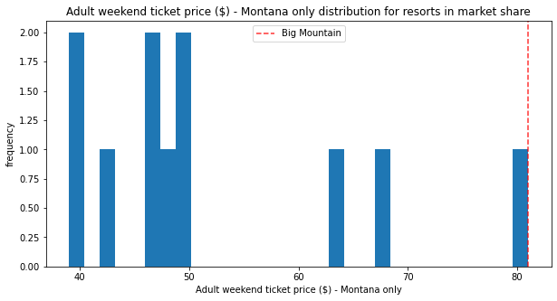
How Ticket Prices Compare?
Above Average Ticket prices nationally
Premium in Montana

Slide 6
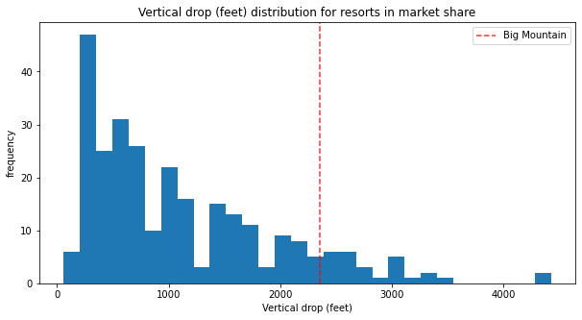
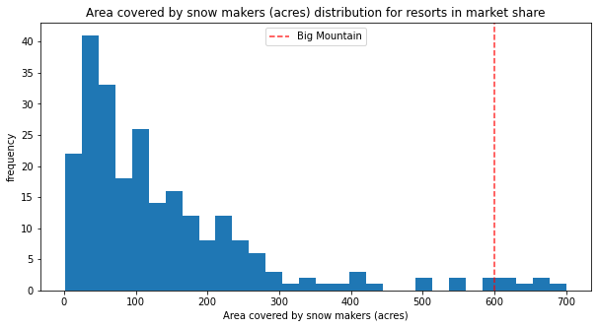
How Other Features Compare?
Vertical Drop: Doing well but can do better
Snow Making : Top of the league table

Slide 7
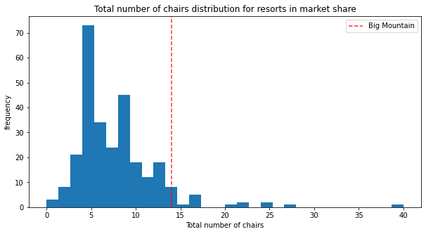
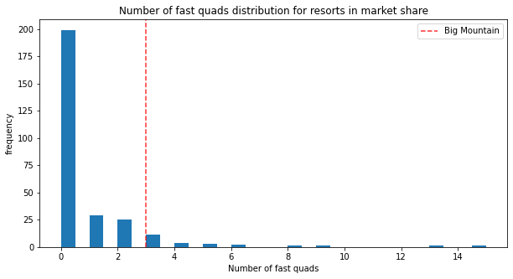
How Other Features Compare?
Chairs: Higher than most.
Fast Quads: High up the league table

Slide 8
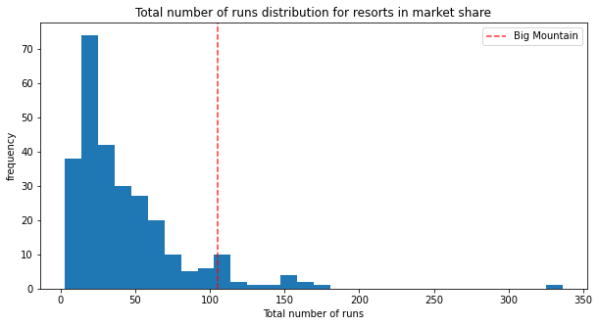
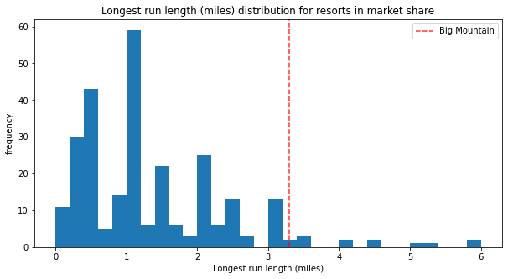
How Other Features Compare?
Runs: Compares well with others
Longest Run: Has one of the longest Runs

Slide 9
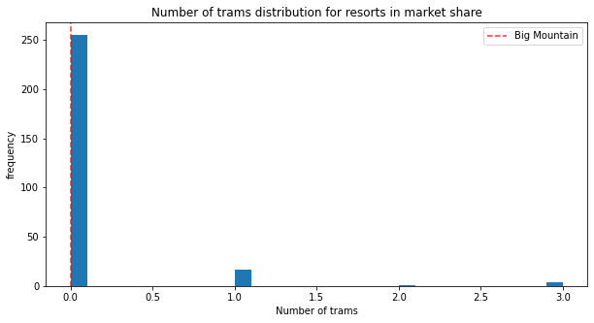
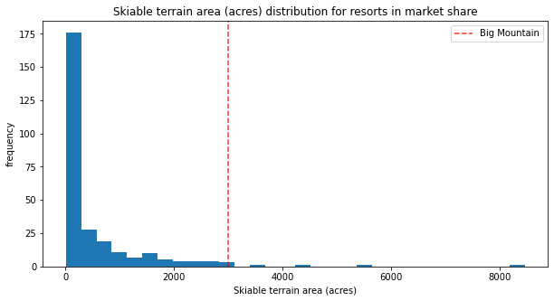
How Other Features Compare?
Trams: No Trams like most other
Skiable Terrain: Has one of the Largest

Slide 10
Summary & Conclusion
Best Scenario: Adding a run + Increasing vertical drop by 150 ft + Installing additional chair lift+ Adding 2 acres of snow making
Best scenario: Ticket price increase by $10.23 & revenue increase by $17905797
Modeled price higher than current price: Features not sufficiently capitalized
Next Step: Analyse cost of investment for best scenario
Next Step: Thorough presentation to Management

